Slide 1
StarServ Automation Project

Slide 2
ClaimSphere Automation Framework Platform
Qaas and Clinical+
Environment
StarServ
Environment
IDE – Eclipse
Web Driver – Selenium
Framework –BDD – Cucumber, TestNG
Build Tool – Maven
Logging – Log4j.xml
Reports – Extent Report
Version Control Tool :Tfs(Git)
CICD – Jenkins
IDE – Eclipse
Web Driver – Selenium
Framework –Hybrid
Build Tool – Maven
Logging – Log4j.xml
Reports –Excel
Version Control Tool :Tfs(Git)

Slide 3
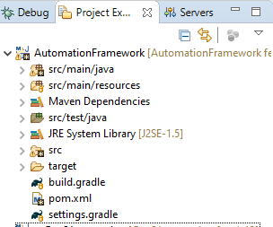
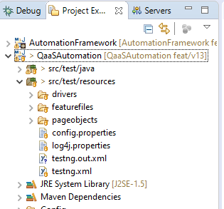
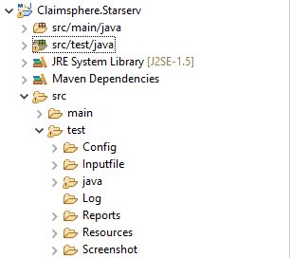
ClaimSphere Framework
Qaas and Clinical Framework Structure
This Project consist of reusable common methods which can be used for all the module
This Project consist of product specific methods
StarServ Structure Project
This project consist of product specific methods

Slide 4
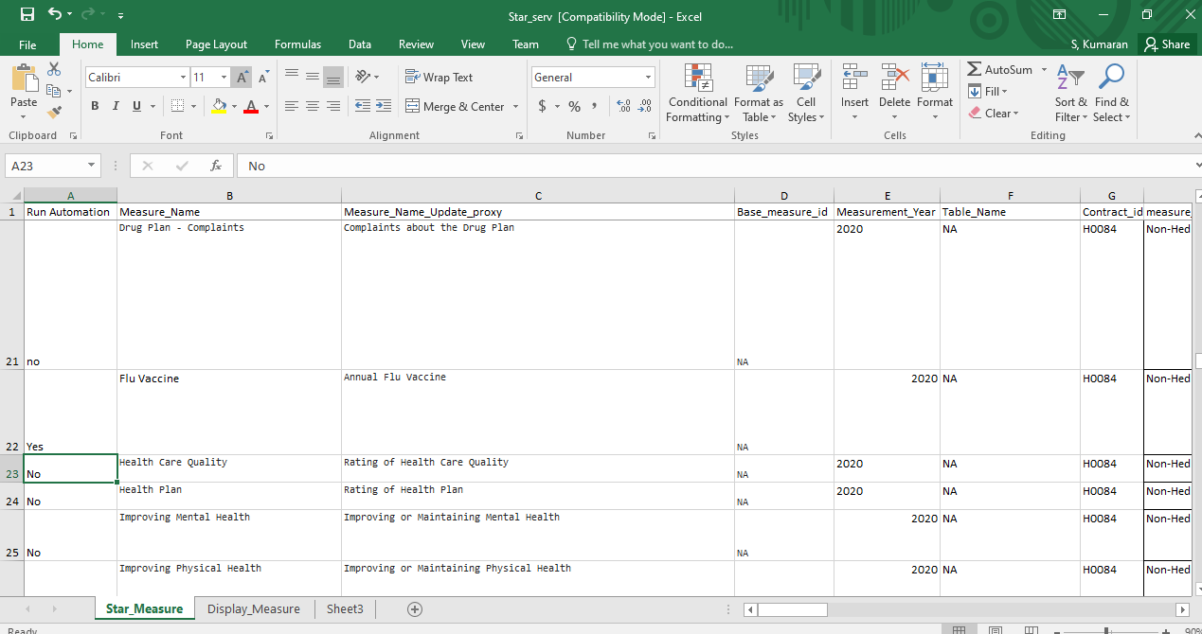
Automation Input File

Slide 5
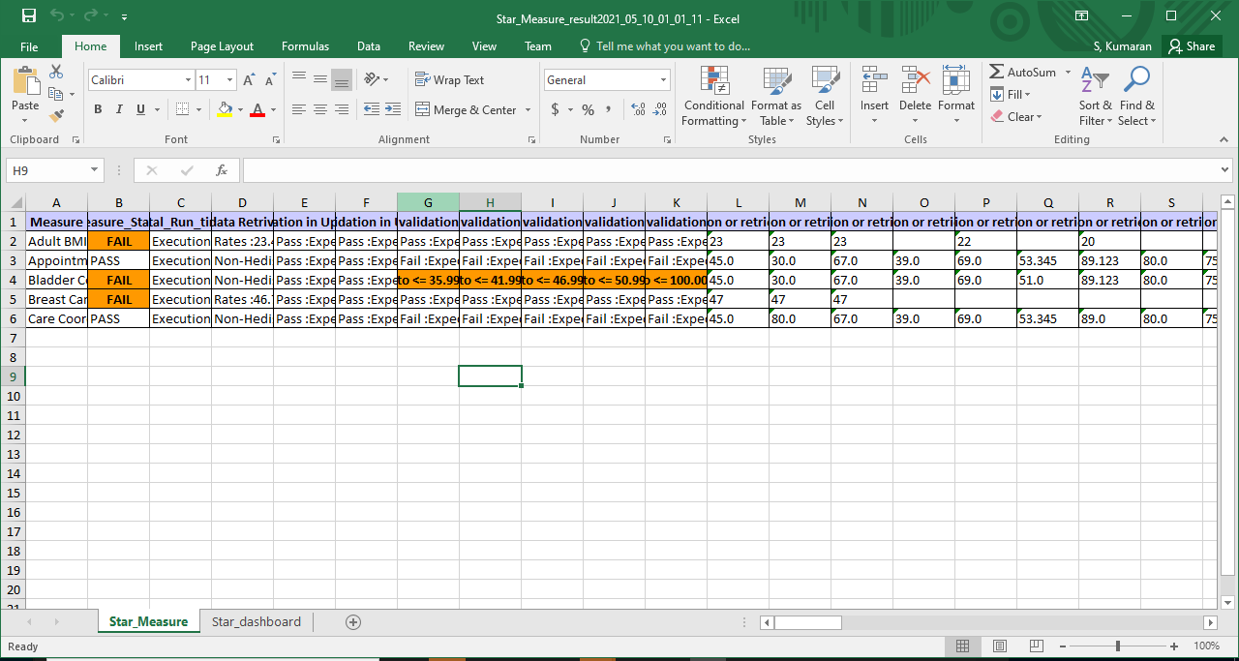
Automation Report

Slide 6
Thank You
.

